Slide 1
COMPANY1
(Year) Marketing Plan
Marketing and Sales
DATE
Notes:
1

Slide 2
Agenda
Situation Review
  Target Market Demographics
  PRODUCT Industry
  Customer Perceptions and Behavior
  YEAR Combined Results
Strategic Positioning
  Mission
  Positioning
  Market Segmentation Strategy

Slide 3
Agenda cont.
YEAR Corporate Objectives
Corporate Communication
Product Strategy & Roadmap
Product Marketing
  PRODUCT
  PRODUCT
Sales Model
YEAR Execution Calendar
Marketing & Sales Organization
YEAR Cost Justification/Budgets

Slide 4
Situation Review
Target Market Demographics

Slide 5
Market Opportunity
Application Focus
COMPANY1
Number of Users Per Business
Market = $0 Businesses
COMPANY2
Large
Businesses
100–500
PRODUCT
PRODUCT
6–100
Small-Medium
Businesses
PRODUCT
1-5
Small
Businesses
PRODUCT
PRODUCT
PRODUCT
PRODUCT
PRODUCT
PRODUCT
PRODUCT

Slide 6
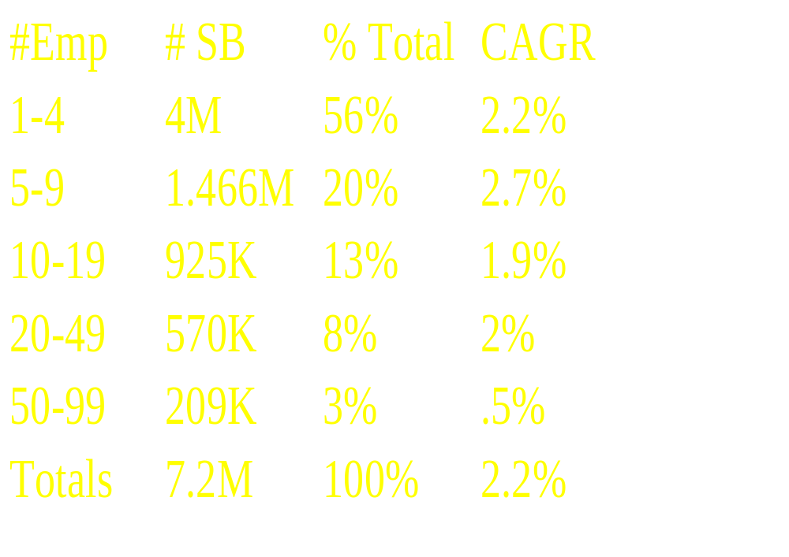
Segmentation by Size

Slide 7
Technology Adoption
By Industry
Business Services
Health Care & Financial
Distribution, Construction, Manufacturer
Early Adopters
Early Majority
Late Majority

Slide 8
Technology Profile
Ave. # of emp.: 9
Ave. Sales:= $2.2M
Ave. # PCs = 4
73% have PCs (5.3M total)
75% have modems
17% have a portable
35% have a multi-media PC
22% of business with PCs have LANs = 1.2M SB in 1997
SB is adding 14K LANs/Mo. - Yr 2000
Less than 10% (100K) connect those LANs to the Internet
Less than 3% (216K) have Web/Home pages

Slide 9
Internet Access & LANs
Objectives for going on-line:
  Improve communications with suppliers and customers
  Better access to information and services
  Improve customer service
  Increase productivity
  Expand markets, sales and profits

Slide 10
Internet Access and LANs
LAN Penetration is growing to 27%+ in 2000 = 1.7M SB
CAGR for LANs = 12%, 6 times the overall SB market CAGR of 2.2%
50%+ (600K) of the SB with LANs have an on-line connection today as a single user to one of the on-line content providers (AOL, Compuserve, ISPs)

Slide 11
Internet Access & LANs
Primary Applications for Internet Access
    Customer/Supplier communications 52%
    Information Retrieval 44%
    Remote offices 38%
Nature of Internet Access
  35% go through the individual PCs
  45% through a single PC shared by many

Slide 12
Web Publishing & Hosting
Home Pages as a percent of all SB
  Only 3% have a home page = 216K SB
  Of on-line SB:
    4% host on premise
    8% are likely to host
    8% have it hosted
    19% are likely to have it hosted (ISP)
  Of on-line small businesses:
    88% don’t have one
    58% aren’t likely to have one
    15% didn’t know
  CAGR for on-line SB is 37% thru 2000

Slide 13
Internet Access, Presence
& LAN Benefits
Over the last 3 years, if you were a small business with a LAN and were on-line, you would have...
  Grown sales over 20% yr/yr more than twice the number of your competitors
  Acquired 40%+ more revenue from interstate business than your competitors
  Acquired three times more revenue from International customers than your competitors

Slide 14
Market Opportunity Summary
1.1M SB with LANs not connected
  Growing at a rate of 14K LANs/mo. through 2000
5M+ SB with a PC and a modem and no Web presence or Home page
“Internet Wave”
Essential “must have” communication tool

Slide 15
Information & Purchase Sources
PC & SW Information
  CPA/Consultant
  Product Reviews in general pubs
  Ads in local newspapers/pubs
  Ads in computer/technical pubs
PC & SW Purchase
  Computer Superstore
  Computer Specialty Store
  Direct Mail
  VAR

Slide 16
Critical Success Factors in Delivering Technology Solutions
Branding & Advertising
Support & Service
Education/Awareness
Out of box experience/Easy
Integrated solution
Scalable & Reliable
Price

Slide 17
Situation Review
PRODUCT Industry

Slide 18
COMPANY Industry Overview
Like other industries have, the COMPANY industry has developed three strategies to compete:
  Overall Price Leadership
    COMPANY
  Differentiation
  COMPANY
  Focus
    COMPANY

Slide 19
COMPANY Target Market
Strategies to Compete
Consumer
Growing Bus.
Large Business
COMPANY
COMPANY1
COMPANY2
COMPANY3
COMPANY4
COMPANY5
COMPANY6
COMPANY7

Slide 20
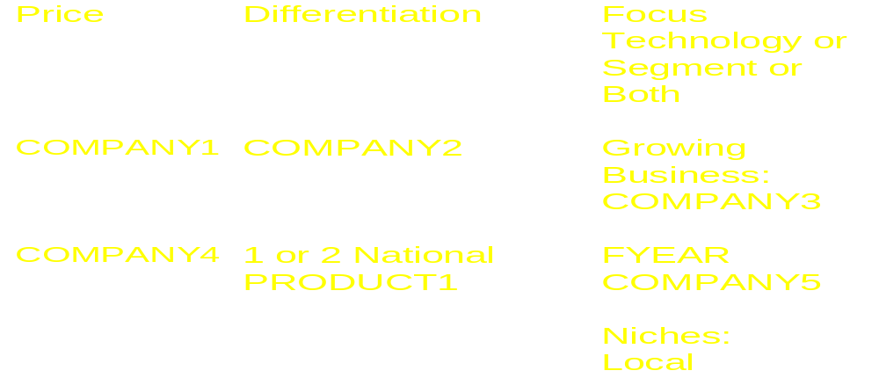
COMPANY Price/Value Strategies To Compete YEAR

Slide 21
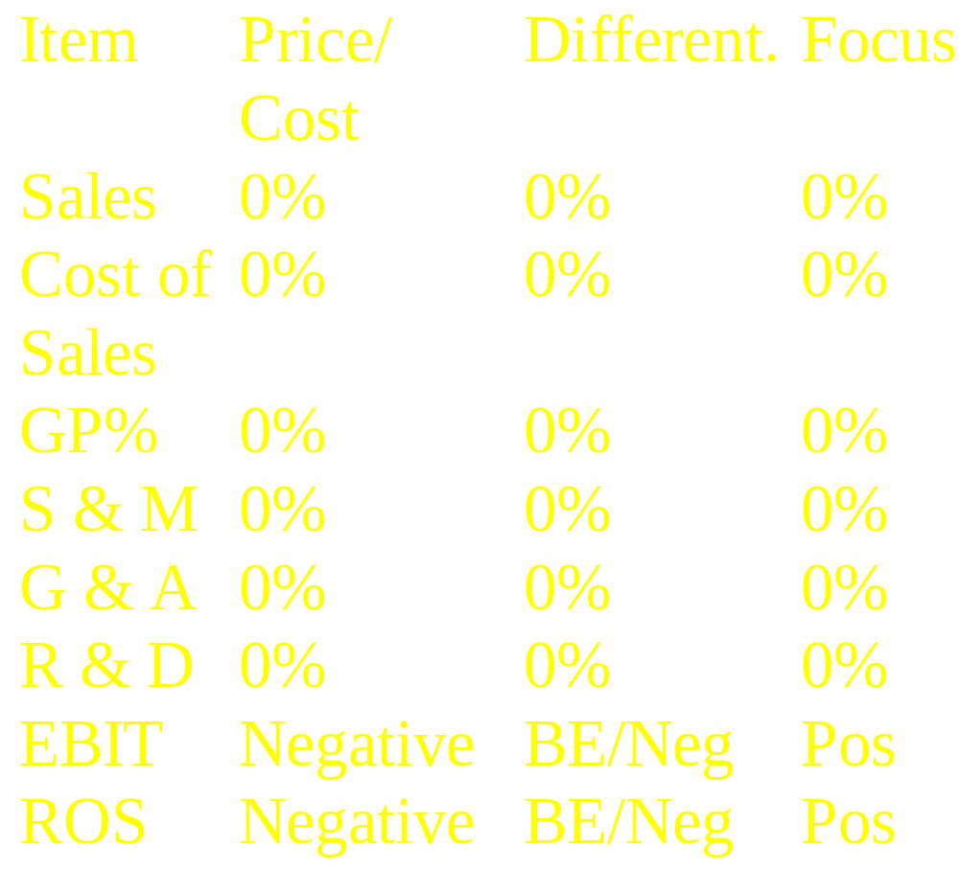
COMPANY Business Models

Slide 22
COMPANY1 versus COMPANY2
COMPANY1
  National PRODUCT
  LAN-to-Internet focus
  Nothing to purchase
  “All-in-one” software & hardware subscription service
  Email/Web/Usenet
  Web Hosting & Wizard
  Dial-up, ISDN, T1, FR
COMPANY2
  Bay Area PRODUCT only
  COMPANY focus
  Dial-up, ISDN, T1, FR
  Internet Roaming
  Sells 3rd party software & PRODUCT
  Web Hosting & Dev
  No Usenet News
  Costs more
  No “all-in-one” subscription service

Slide 23
COMPANY1 versus COMPANY3
COMPANY1
  National PRODUCT
  LAN-to-Internet focus
  Nothing to purchase
  “all-in-one” software/hardware subscription service
  Email/Web/Usenet
  Web Hosting & Wizard
  Not a content provider
COMPANY2
  Strong Content provider with International Internet Access
  Consumer focus, over $0 accounts
  No Web Wizards
  Dial-up only
  No “all-in-one” subscription service

Slide 24
COMPANY1 versus COMPANY4
COMPANY1
  National PRODUCT
  LAN-to-Internet focus
  Nothing to purchase
  “All-in-one” software/hardware subscription service
  Email/Web/Usenet
  Web Hosting & Wizard
COMPANY2
  # state PRODUCT only
  Very limited trial PRODUCT services for Dial-up, ISDN & ADSL
  Not yet committed to offering Internet Access

Slide 25
Situation Review
Customer Perceptions & Behavior
NOTE; THE PRODUCTS CONTAINED IN THIS SECITON ARE ONLY FOR EXAMPLE PURPOSES

Slide 26
Primary Market
Research Results
Research Objectives for LAN Access & Web Wizards
  Measure customer satisfaction
  Understand purchase decision process
  Identify COMPANY product needs
Methodology
  # Customers, # Prospects - pre-merger COMPANY
  Phone interviews
  Open ended questions

Slide 27
Research Results cont.
0% were not satisfied with COMPANY due to:
  Billing errors, timeliness
  Access speed
    Email & browser overall
    Busy times
  System stability/too much downtime
  On-line support tools weak

Slide 28
Research Results cont.
  Tech Support
    Hold times are too long
    Follow up is poor
    Reps need more technical knowledge to fix my problems faster
    Problems not resolved…they stay open
  Price is too high

Slide 29
Research Results cont.
Why did they buy?
  A complete software, hardware, access solution
  Integration with existing Email system
  Ease of implementing
  Ease of administering/ability to manage
When asked to choose just one reason….
  Integration with existing Email system

Slide 30
Research Results cont.
From a Web Hosting perspective, the single biggest decision driver is going with ONE firm for both access, email, and Web
For both access and Web, the key decision drivers are:
  Cost
  Ease of install and use
  Ability to manage access, email, Web
All other demographic data confirms the IDC report numbers

Slide 31
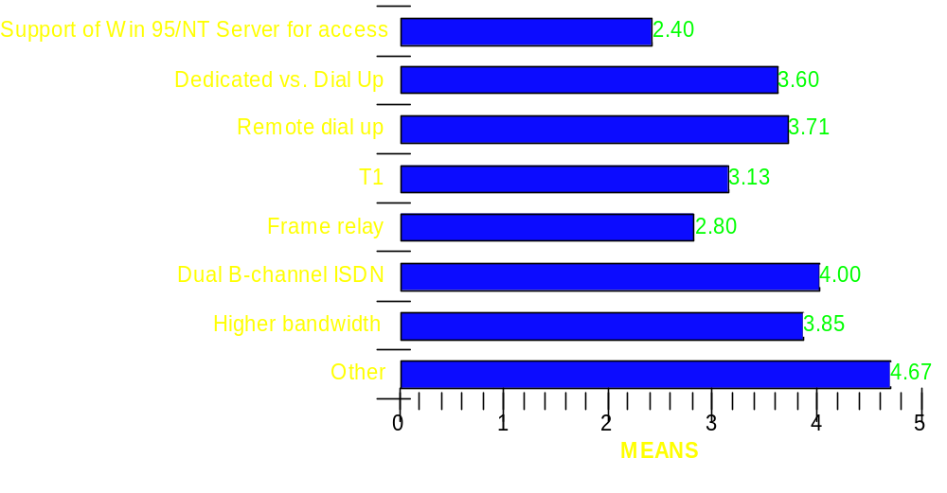
Access Feature Requests

Slide 32
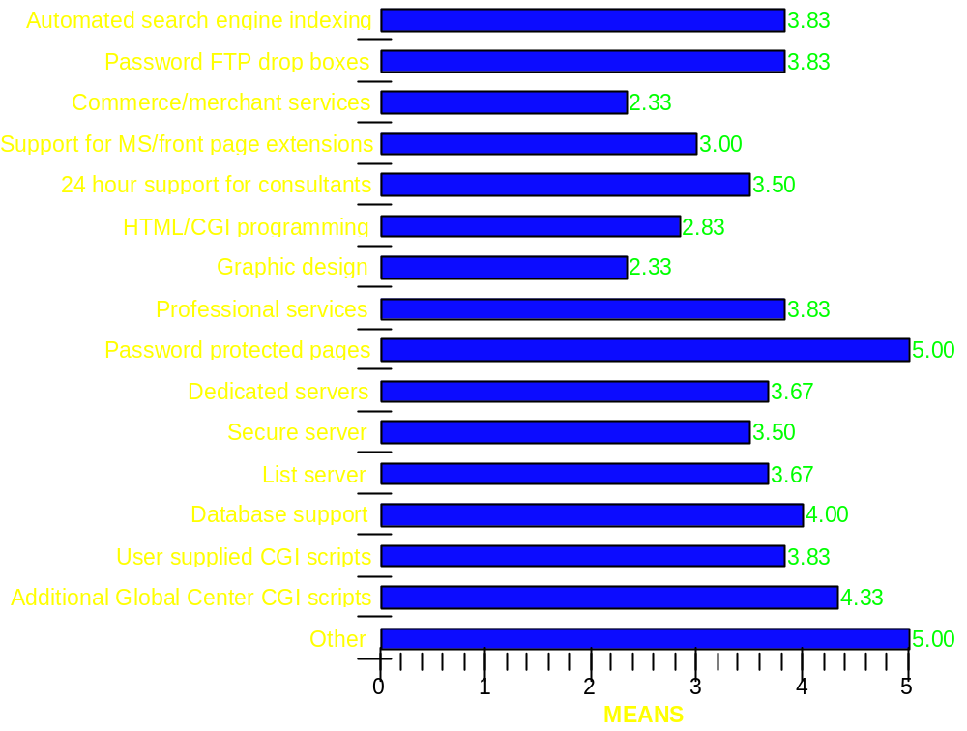
  Web Feature Requests

Slide 33
(Year) Combined Results

Slide 34
(Year) Sales Forecast

Slide 35
Strategic Positioning

Slide 36
The New COMPANY
Mission

Slide 37
The New COMPANY
Positioning
COMPANY differentiates itself by:
New breed of COMPANY— COMPANY
A focused target market—growing businesses
By providing the complete “management solution” (software, hardware, support etc) that the market requires
Application software for Internet, LAN, and WAN communication for that market
Convenient subscription based pricing

Slide 38
Segmentation Strategy

Slide 39
Segmentation Strategy
Approaches
  Segment by vertical markets
  OR…
  A broad based approach within our target growing business market

Slide 40
Segmentation Strategy cont.
Recommendation: Both
Segment the Target Market by niches that references each other and a broad based approach that complements the vertical focus
  Target the following specific niches within the Business Service vertical:
  Marketing
  Accounting
  Legal

Slide 41
Segmentation Strategy cont.
Media approach will vary by segmentation strategy
  Print Broad - All SMORGs
  Editorial Broad - All SMORGs
  Direct Mail Business Services Vertical
  Telemarketing Business Services Vertical
  Seminars Business Services Vertical
  Email/WWW Both
  Affiliation/Assoc. Business Services Vertical

Slide 42
Segmentation Strategic Goals
XXX% of Small Business with LAN Access (#):
  XXX# LAN business subscribers
  At $XXX per month = $XXX annually
XXX% of all Small Bus./non-LAN Access (#+)
  XXX# businesses at $0/month = $XXX
XXX% Web Hosting Market Share Goal (#+)
  XXX# Web Hosting Customers at $XXX per month = $XXX
Total Business Opportunity: $XXX+

Slide 43
Access Marketing Strategy
Access Application
End User Market
Mktg..... Priorities
Number of Users Per Business
Market = 0 Businesses
Large
Businesses
100–500
Print Ads & Editorial
Direct Mail & Electronic Mktg.....
6–100
Small-Medium
Businesses
PRODUCT
1-5
Small
Businesses
PRODUCT
Vertical - Business Affiliation
General - Editorial
PRODUCT
PRODUCT

Slide 44
Web Marketing Strategy
Web Application
End User Market
Mktg..... Priorities
Number of Users Per Business
Market = 0 Businesses
Large
Businesses
100–500
6–100
Small-Medium
Businesses
Electronic & Direct Mktg.....
Outbound Telemktg
PRODUCT
1-5
Small
Businesses
PRODUCT
Vertical - Business Affiliation
General - Print & Editorial Bundle with Access
PRODUCT
PRODUCT

Slide 45
SWOT Analysis
Employee Perspectives

Slide 46
Strengths
• Hot market niche/perfect time for this product
• National presence
• Subscription Model
• COMPANY Manager software
• Our product is a great, inexpensive turnkey solution for small companies
• Easy to use software
• Great people - technical strength & totally dedicated to helping the company succeed.
• The mail products are on the right track for meeting customers needs, works with most customers’ existing LAN’s

Slide 47
Weaknesses
• Competition from below beats us on price and from above on features
• Difficult to differentiate from competition; no clear value-add
• Lack of strategic alliances and partnerships
• No Frame or T1/Lack of higher data rate solutions
• Proprietary solution-can’t use other brand H/W
• Dependent on a LAN which we don’t have control over

Slide 48
Weaknesses cont.
• When it is not managed/working right it is VERY expensive/High Access charges
• Our product is much more difficult to set up than our literature leads you to believe
• Lack of visibility and market awareness...no marketing!
• Our story is hard to tell

Slide 49
Opportunities
• Vertical Market domination possible through:
Partnerships
Co-branding and other joint ventures
VAR partnerships in target industries (pre-press, real estate)
OEM
Distribution
PRODUCT, and package deals for web designers responsible for multiple sites.

Slide 50
Opportunities cont.
• Need higher bandwidth solutions now
• Small business PRODUCT shops-PRODUCT owners expect a lot from our software. COMPANY can be that stellar software if they focus on quality and superior design.
• Make sure people are rewarded for communicating with others and for being team players
• Work with Small Business Administration to help new businesses get going in the Internet world.

Slide 51
Opportunities cont.
Improve our quality of services
Since every COMPANY is in a position that customers are not completely satisfied with their services, we need to start “stealing” other COMPANY customer like they did to us.
Spend significant money on marketing...we have a great product and no one knows about it.
• Growing market confusion = need for turnkey, simple solution
• No market leader yet for small LAN access

Slide 52
Threats
• Commodity pricing in access and web hosting markets
• Lack of useful strategic relationships and partnerships
• Narrowing windows of opportunity
• COMPANY coming on strong as COMPANY
• COMPANY could lease bundle
• Disgruntled customers that spread the bad word

Slide 53
Threats cont.
• Other COMPANY-competition with lower prices-competitors could leapfrog us with better technology development,other companies that can do it for cheaper, particularly COMPANY
• Our own quality of services
• If we do not market we will die.

Slide 54
(Year) Corporate
Marketing and Sales Objectives

Slide 55
Marketing Objectives
Positioning
  Establish the COMPANY segment, our leadership position in it, and own it
Branding : Develop a branding strategy that
  Incorporates acquisitions seamlessly
  Communicates the PRODUCT1 & PRODUCT2 relentlessly
  Minimizes customer confusion/disruption

Slide 56
Marketing Objectives cont.
Product Strategy: Develop a two year product roadmap that:
  Creates new markets via breadth of line
  Provides a migration path via depth of line
  Provides a long term sustainable competitive advantage
  Increases and diversifies revenue streams
  Is driven by the customer
  DELIVERS PRODUCTS ON TIME!

Slide 57
Marketing Objectives
All Products
  Be the #1 market share company in our target market of growing businesses in YEAR
  Be the #1 provider of PRODUCT products sold and supported through indirect channels
  Be #1 in mindshare
  Provide best in class quality of service as determined by our customers
  Generate $XXX of end user demand

Slide 58
Marketing Objectives cont.
Develop installed base programs to:
  Upgrade XXX% of dial up customers to dedicated and/or LAN access
  Upgrade XXX% of access customers to Web Hosting services as well
  Keep churn below XXX% annually

Slide 59
Marketing Objectives cont.
Close # Strategic, High Marketing Leverage Alliances
Develop and own the “vertical business affiliation” channels
Develop key cross functional processes
Build a world class Marketing Team

Slide 60
Sales Objectives
Develop and execute a multi-channel sales strategy that achieves $XXX in revenue:
  Retail $XXX
  Direct Response $XXX
  OEM $XXX
  Telesales $XXX
Build the industry’s #1 productive sales team

Slide 61
Sales Objectives cont.
Develop and execute sales programs that achieve:
  Access PRODUCT $$$$ YR/YR
    Dedicated Access $XXX XXX%
    LAN Access $XXX XXX%
    Dial Up $XXX XXX%
    Access PRODUCT $XXX XXX%
  Web PRODUCT $XXX XXX%
  Total Business $XXX XXX%

Slide 62
Corporate Communication

Slide 63
Positioning
By DATE, develop a complete COMPANY:
  Corporate positioning white paper
  Press/analyst kit & presentation
By DATE, complete # city, press/analyst tour
By DATE, develop new collateral, ads, direct mail, packaging, customer success stories etc. to reflect the new positioning
COMPANY will be the company brand and is critical to our positioning plan

Slide 64
Branding Strategy
COMPANY will be branded with all products
Access and Web Families will have similar names for each level of service that a customer will buy
  The names on the next few slides are placeholders until DATE when the final branding plan is complete
Leverage the existing COMPANY brand for all non-LAN dial up customers
Rename the COMPANY PRODUCT product within all overall PRODUCT brand

Slide 65
Branding Strategy cont.
Technology within each product will be branded whenever possible
Business value and unique selling propositions will be branded

Slide 66
Access Branding Strategy
Access Application
End User Market
Brand
Number of Users Per Business
Market = 0 Businesses
Large
Businesses
100–500
“COMPANY”
6–100
Small-Medium
Businesses
PRODUCT
1-5
“COMPANY”
Small
Businesses
PRODUCT
“COMPANY”
PRODUCT
PRODUCT

Slide 67
Web Branding Strategy
Web Application
End User Market
Brand
Number of Users Per Business
Market = 0 Businesses
Large
Businesses
100–500
PRODUCT
6–100
Small-Medium
Businesses
PRODUCT
1-5
PRODUCT
Small
Businesses
PRODUCT
PRODUCT
PRODUCT
PRODUCT

Slide 68
Media Plan

Slide 69
Public Relations Plan

Slide 70
PR Plan
Obtain the #1 mindshare position by securing:
  Reviews in key vertical business pubs
  Speaking engagements in vertical industries
  Coverage in the local news around our PRODUCT Hubs as well as local POPs
  Awards for innovative, high quality products in key technical magazines
  Coverage in key newsgroups, discussion forums, and popular small business Internet sites on tips, techniques, community programs

Slide 71
PR Plan cont.
Secure extremely wide coverage via a press release “blast” strategy:
  Silver: # PR per week - Business Wire
  Gold: # PR every other week to various verticals with teleconference calls
  Platinum: # PR every month: “pre-release, leak, exclusive” to our most important press
Develop XXX end user reference accounts covering our entire product line for press, analysts, and releases

Slide 72
Product
Strategy & Roadmap

Slide 73
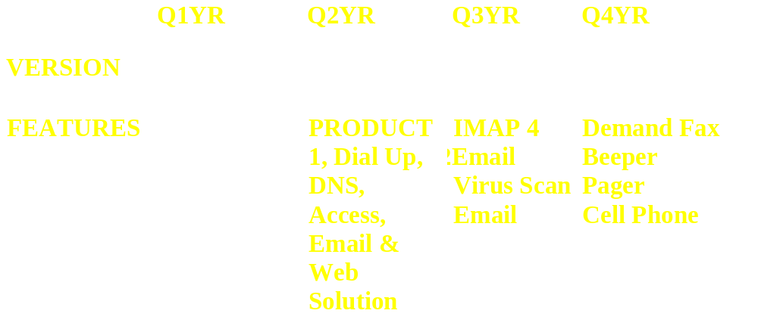
(Year) Dial Up Access
Product Roadmap

Slide 74
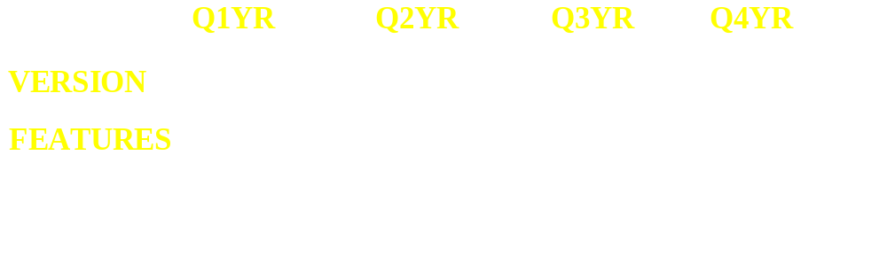
(Year) Dial Up Access
Product Roadmap

Slide 75
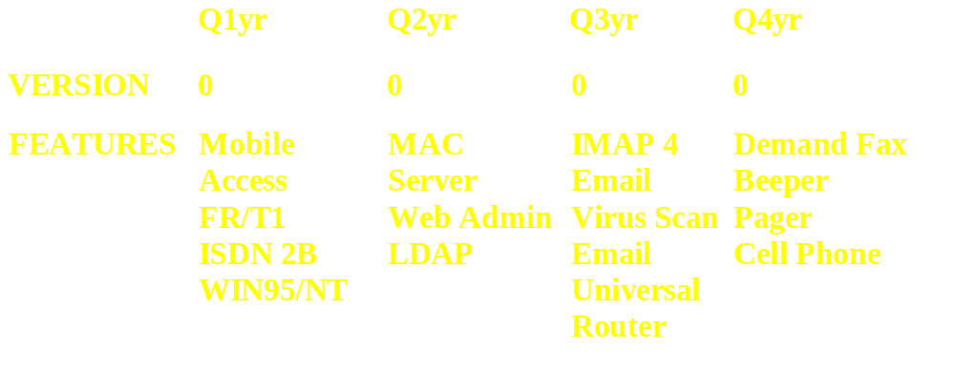
(Year) LAN Access
Product Roadmap

Slide 76
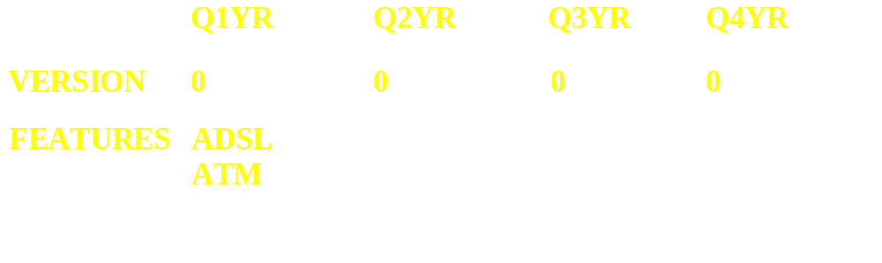
(Year) LAN Access
Product Roadmap

Slide 77
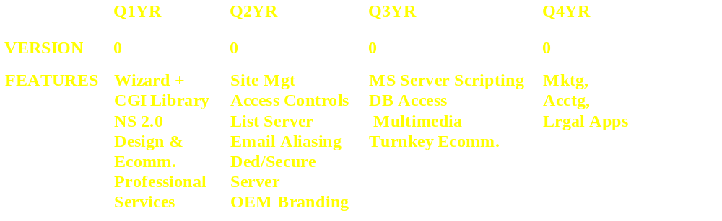
(Year) Web
Product Roadmap

Slide 78
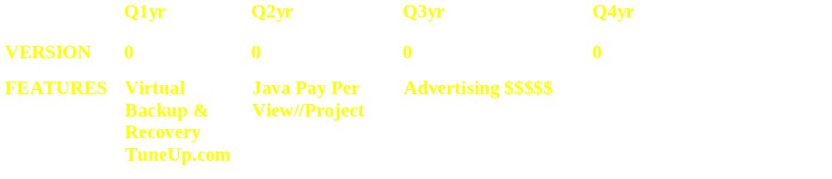
(Year) Web
Product Roadmap

Slide 79
Product Marketing

Slide 80
Installed Base Marketing
By DATE, develop the information required and process to profile the database and keep current for targeted marketing programs
By DATE, profile the current customer database via outsource telemarketing, email and Web surveys:
  Business or consumer
  Demographics
  Purchase Intentions for LAN, Dedicated Access, and Web Products

Slide 81
Installed Base Marketing
By DATE, launch email, direct mail, outbound telesales, and promotional programs to upgrade:
  # single or multi - account dial up/ISDN customers to LAN (#) & Dedicated Access (#)
  # analog dial-up customers to ISDN
  # customers to Web Wizards
  # customers to Web Professional Services and E Commerce
By DATE, develop and launch a “COMPANY” program to reduce churn to 0% annually.

Slide 82
Strategic Alliances
By DATE, identify the top # industry vendors appropriate to COMPANY and assign:
  Point person for each vendor from Product Marketing & Corporate Communications
  # key vendors per COMPANY Executive
  By DATE, develop and launch programs with at least # vendors

Slide 83
Affiliation Programs
By DATE, identify the top:
  # associations each for Marketing, Accounting, Legal segments
  # fund raising firms
  Special focus on low subscriber count PRODUCT cities

Slide 84
Affiliation Programs
By DATE, launch recruitment programs for each of the segments as appropriate to drive an incremental:
  # dial up accounts
  # LAN Access accounts
  # Web Wizard accounts
  # Professional and COMPANY accounts

Slide 85
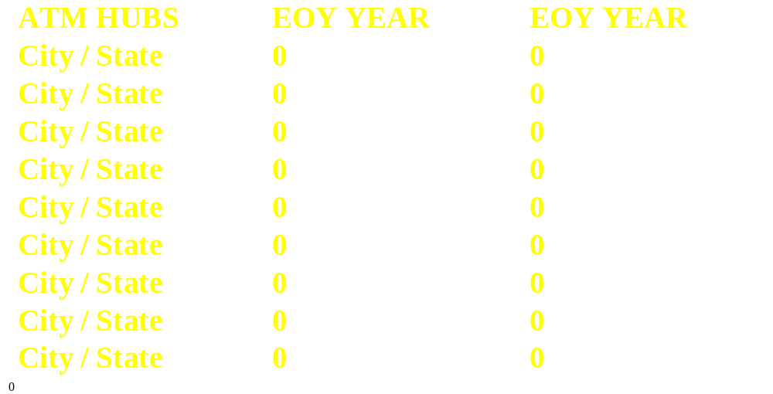
ATM City Objectives

Slide 86
Access Promotion Programs

Slide 87
Web Promotion Programs

Slide 88
Operational Excellence Programs
Benchmark our key competitors along the major service metrics
Obtain the customer satisfaction expectations by product
  Establish service level guarantees by DATE
Conduct monthly customer satisfaction surveys and compensate Technical Support and Operations on the performance

Slide 89
Operational Excellence cont.
Conduct monthly “customer phone interviews” with the entire company present to receive direct customer feedback
Brand the “customer delight” and operational excellence program and use as a competitive weapon by DATE

Slide 90
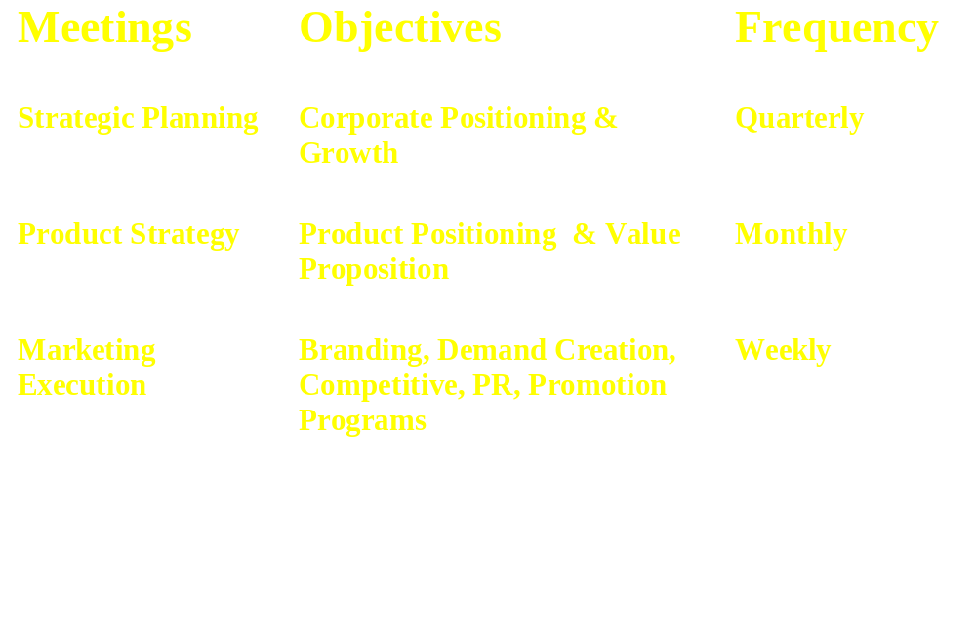
Cross Functional Processes

Slide 91
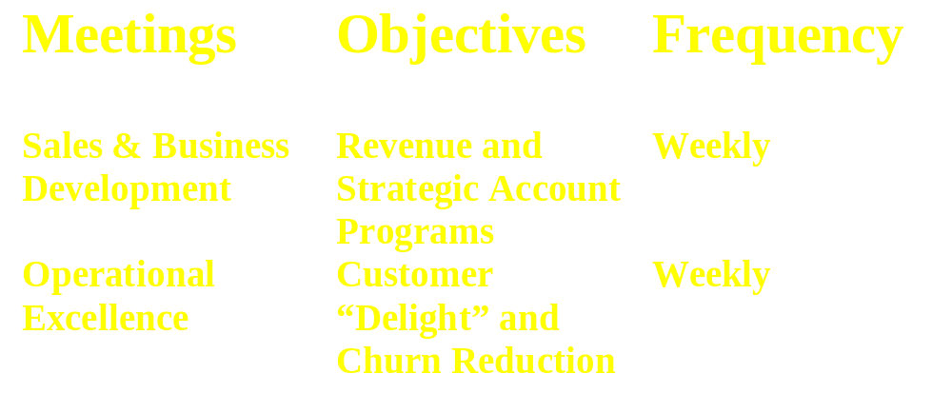
Cross Functional Processes cont.

Slide 92
Sales Model

Slide 93
Access Sales Channel Map
Access Application
End User Market
Sales Priorities
Number of Users Per Business
Market = 0 Businesses
Large
Businesses
100–500
Outbound Telesales
When turnkey - Indirect Channels
6–100
Small-Medium
Businesses
PRODUCT
1-5
Small
Businesses
Indirect - OEM ,Retail, DR
Direct Telesales Upgrades
PRODUCT
Direct Inbound Telesales (Business Affiliation Programs)
OEM
PRODUCT
PRODUCT

Slide 94
Web Sales Channel Map
Web Application
End User Market
Sales Priorities
Number of Users Per Business
Market = 0 Businesses
Large
Businesses
100–500
6–100
Small-Medium
Businesses
PRODUCT
Outbound Telesales/FS
Indirect Channels
1-5
Small
Businesses
PRODUCT
Direct Inbound Telesales (Business Affiliation Programs)
PRODUCT
PRODUCT

Slide 95
Sales Channels Sequencing
Retail/Mail Order: QTR Launch; QTR Benefits
OEM: QTR Pilot; QTR Launch; QTR Benefits
  Office Equipment; Small Business Services
  COMPANY / Long Distance Carriers
Note: These indirect channel program details will be finalized by DATE with direct customer input
Telesales
  All inbound in CITY/STATE - DATE
  Outbound - Outsource Broad Based; CITY/STATE based for Product Specific Sales
    Final plan due DATE

Slide 96
Execution Calendar

Slide 97
Organization

Slide 98
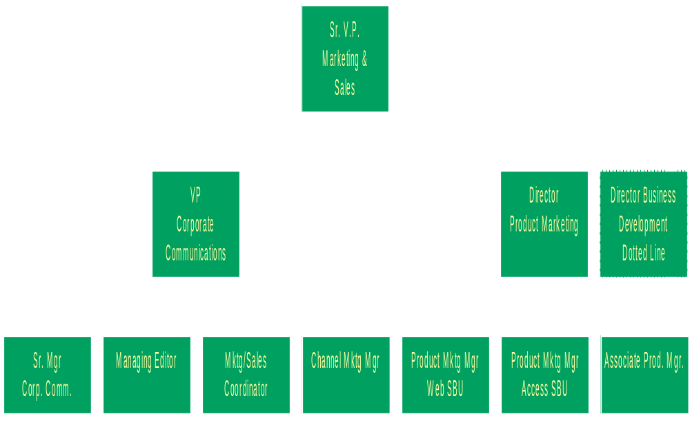
(Year) Marketing Organization

Slide 99
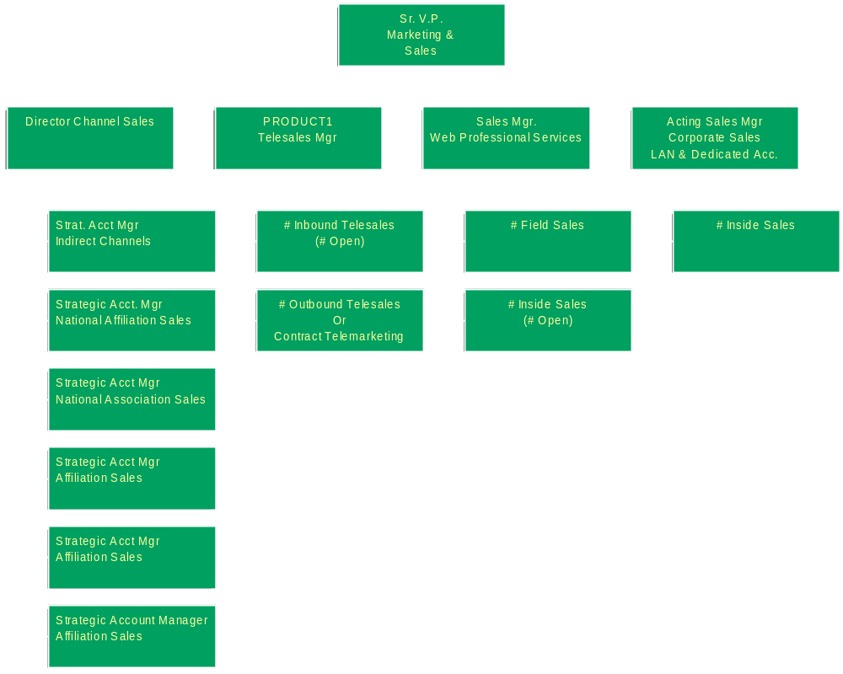
(Year) Sales Organization

Slide 100
Cost Justification

Slide 101
Media Budget

Slide 102
PR Budget

